Slide 1

Our Mission
Live, Love Believe

Slide 2
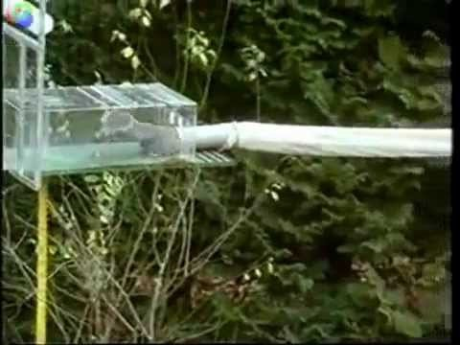
What is a Mission Statement?
Notes:
Have you heard of the mission impossible films? These are films when someone is brave and agrees to go on a mission to save the world. They could not save the world siting down. They accept the mission which means they have to go out and show through their actions what they believe in.
So a Mission is the way that we show others what we believe in.
This can be difficult sometimes and so we need to persevere. Just like the squirrel

Slide 3
What is a mission?
Our school has a Mission – this is the explanation of what is really important to us.

Slide 4

What is our Mission?
When Pope Francis visited the children in Mexico City after the Earthquake – he said to them that they needed to
Live
Love
Believe
We will use these words as our Mission.

Slide 5
Live
What do I do in my life so that I can be the best I can be for God?
Notes:
Actions – Who am I?
What can I do better
What is my vision for the future of me – how do I get there = learning

Slide 6
Love
How do I show God’s love to others that I meet?
Notes:
How do I treat others
How can I show God’s love to others and myself
What does my behaviour show about who I am?

Slide 7
Believe
How does what I believe in affect others that I meet and do not meet?
Notes:
Belief is faith in action – works of charity, eco warriors, stewardship

Slide 8







What are Virtues?
These three simple words can be tricky to do every day, especially if we wake up in a GRUMPY mood!
God knows this and he helps us by giving us VIRTUES to guide us.
We are going to use seven virtues to help us live out our Mission.
They are
Faith Hope & Charity
Wisdom Justice Courage & Self Control
Notes:
This can be overwhelming for the children.

Slide 9
How will this be experienced within the school?
We will learn together how our actions in living out the Mission show the Virtues.
We have stickers and postcards to celebrate this with you.
We will also display photos in the school and share this with
parents in the newsletter/ClassDojo
Notes:
Ask the children how they would like to do this. Do they want to use the prayers, do they want Virtue champions weekly? What ideas do they have?

