Slide 1

Faith | St Mother Teresa | Parable of the Mustard Seed
Hope | Daniel | Parable of the prodigal Son
Charity | Blessed Pier Giorgio Frassati | The widow’s mite
Wisdom | Samuel | The wise and foolish builder
Justice | Oscar Romero | Parable of the unjust judge
Courage | Maximilian Kolbe | David and Goliath (Not a parable!)
Self - control | St Moses the Strong | Parable of the Sower

Slide 2
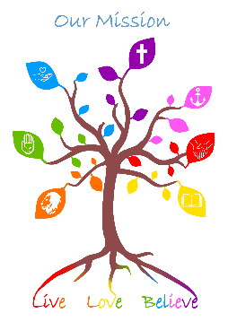
Faith
St Mother Teresa
Mother Teresa is mostly known for her charitable work, rather than her life as a missionary.
In 1950, she established the Missionaries of Charity - an organisation that cared for people in extreme poverty.
In India, lots of people were afraid of diseases like leprosy or AIDs. But, through this organisation, Mother Teresa cared for them.
The congregation raised funds to build orphanages, hospitals and homes for the ill. Volunteers from the charity ran these places, including Mother Teresa.
In 1979, she received the Nobel Peace Prize for her charity work. In 2016, Pope Francis canonised her as a Saint in the Catholic Church.
“Not all of us can do great things. But we can do small things with great love.”
Did you know that whilst millions of Christians admire Mother Teresa for her work with children and adults who society had rejected, she felt that she was not good enough and she questioned her faith.
It can be hard to believe and to act differently because of our beliefs. By keeping going even when things get tough that is true faith.

Slide 3
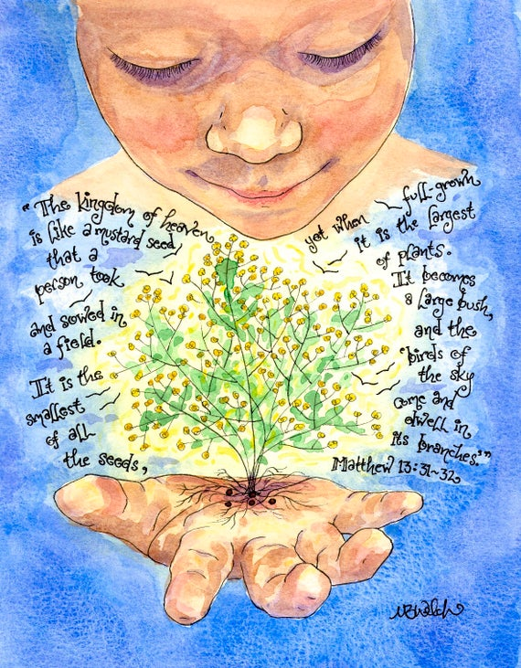

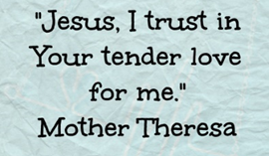
Faith
Parable of the mustard seed shows that faith starts as a small thing like a seed but can grow large and strong like a tree.
Virtue prayer of faith

Slide 4

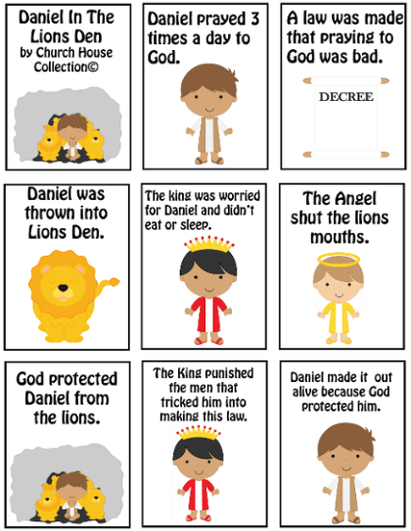
Hope
Daniel believed in God. He prayed to God because he believed.
He was treated badly because of his faith.
He hoped that his faith would keep him safe when he was thrown in with the lions.
God kept him safe!

Slide 5

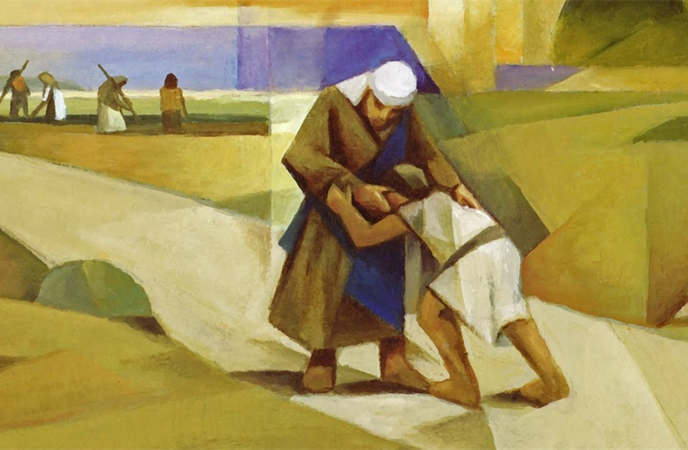
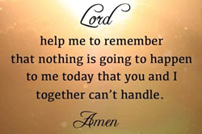
Hope
Once the son had wasted all the money that his father had given him, when all his friends had disappeared and when all that the son had let to him was eating the scraps that he was feeding to the pigs – the son felt he had nothing left.
He admitted to God and to himself that he had done wrong.
He thought about his father and what a kind and fair person he was. He began to hope. He hoped that his father would take pity on him.
This hope was strong enough to take him on a journey back to his father. His hope was rewarded when his father came to meet him and hug him, welcoming him back to the family.
God always meets our hope for forgiveness with open arms just like the father in the prodigal son.
Parable of the prodigal son
Virtue prayer of hope

Slide 6
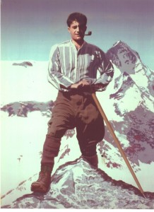

Charity
Pier Giorgio Frassati
Some people have called Pier, or Peter, Frassati a saint for today’s young people. He was handsome and athletic. He hiked, climbed mountains, rode horses, and skied with his many friends. He loved to laugh, and he was famous for his practical jokes. He loved life and lived it to the fullest.
Pier was born in Turin, Italy, in 1901. His mother was an artist and his father founded and ran the Italian newspaper La Stampa. As he was growing up, Pier developed two habits that became part of his everyday life. He went to Mass daily to receive the Eucharist, and he also prayed the Rosary. He never hesitated to share his faith with others.
Pier had a great concern for the poor, even as a child. One day a needy mother with a young son came to the Frassati home to beg for food. Pier noticed that the child was barefoot. He took off his own shoes and gave them to the boy, and then he and his mother fed the poor family. Pier used the money he got as a graduation gift to rent a room for a woman who had been evicted from her apartment because she had no money. He gave away his allowance to the poor, and sometime he chose to walk home from school because he gave the money for his bus or train fare to someone in need.
He joined the St. Vincent de Paul Society as a young man and spent hours on activities that helped the poor and sick. As a mining engineer, he cared deeply about the rights of the miners. He wanted them to have just working conditions and fair wages.
When he was 24, Pier became very ill with polio. Some people said he got this disease from caring for people in the slums of Turin, but Pier saw Jesus in the people he served. In his last days, he whispered the names of people who still needed assistance to his family and friends who gathered at his bedside. He died on July 4, 1925.
Blessed Pier
Giorgio Frassati
How do we care for the poor?
Can we do more?

Slide 7
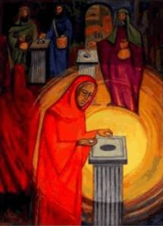

Charity
The widow gave two coins which was all she had. Jesus praised her actions because she did everything she could.
Can we show Charity in our daily lives?
Virtue prayer of charity

Slide 8
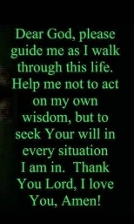
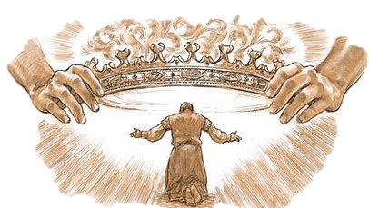

Wisdom
King Solomon
Solomon took over as King from David. When God chose him Samuel asked for wisdom to be a good king. God gave him wisdom and Solomon used this to guide others how to live their best lives and to be good for God.
Wisdom is knowing the right thing to do in difficult situations.
Virtue prayer of wisdom

Slide 9
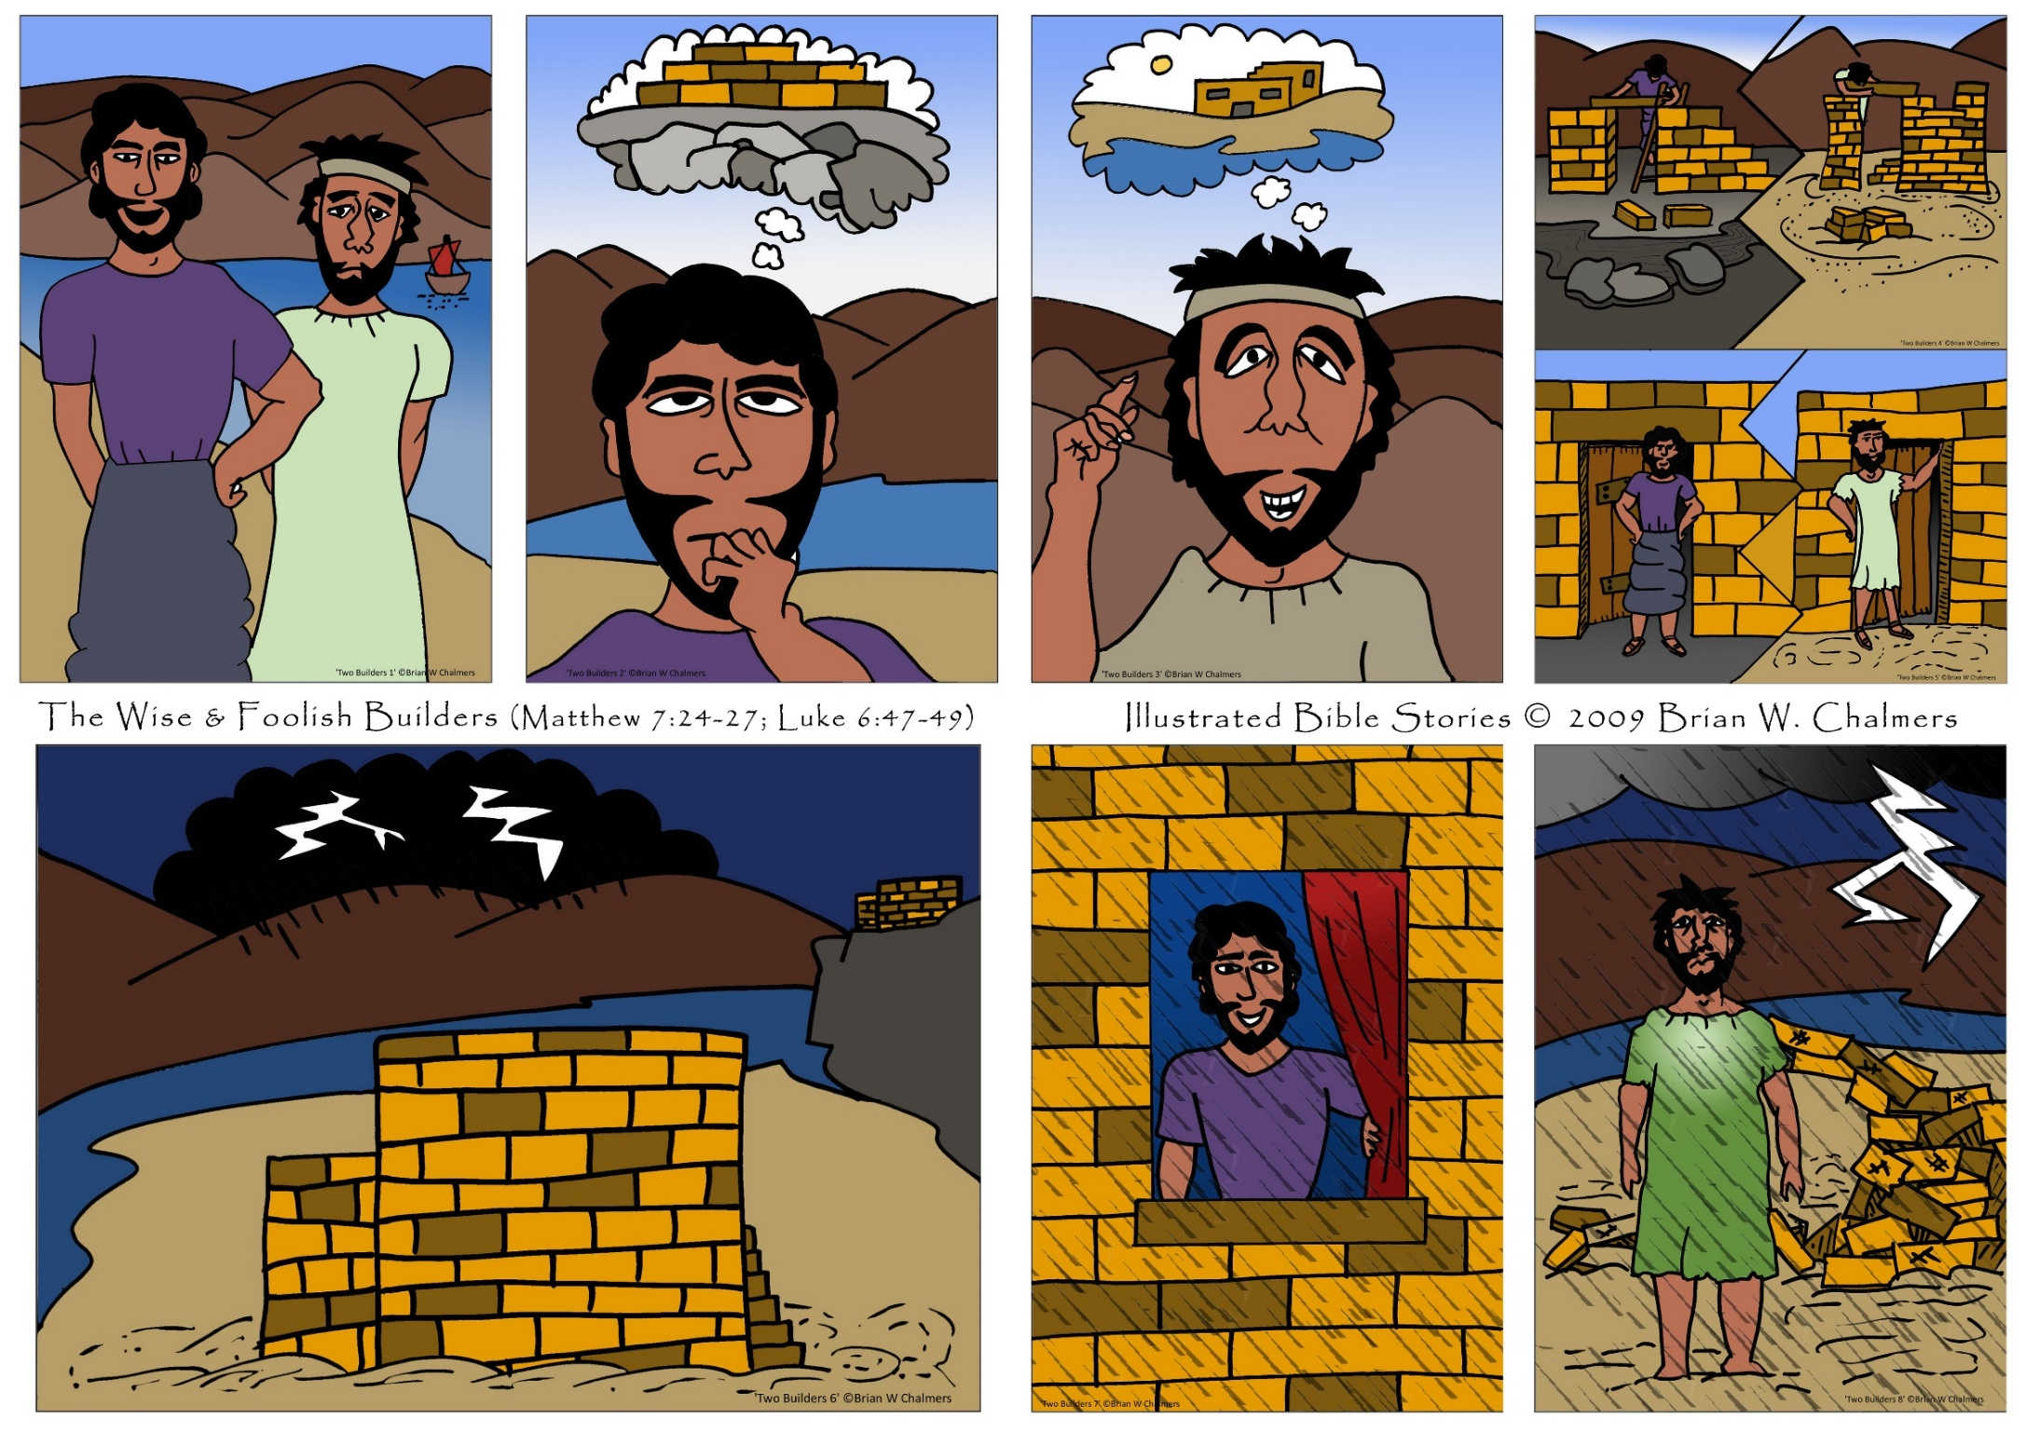
Wisdom
Parable of the wise and foolish builder
Do you think that you always build your house on rock – or do you sometimes not use wisdom in your judgements?

Slide 10
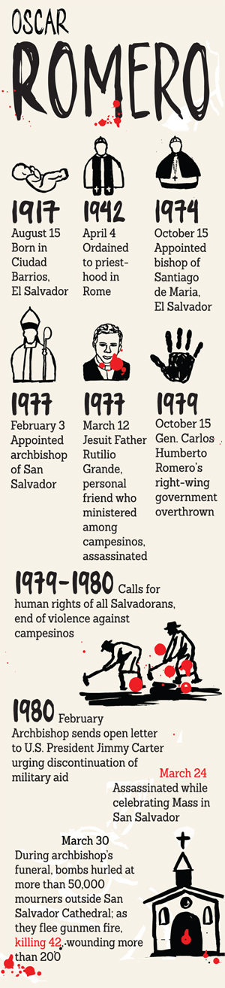
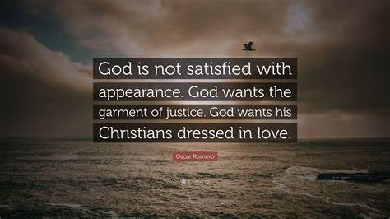
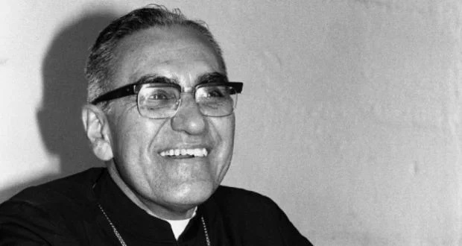

Justice
Oscar Romero
As a bishop, Oscar Romero started to see that people were being treated unkindly by the government.
It would have been very easy for him to ignore this and just to say prayers in church for the people being hurt. Oscar Romero instead spoke out about the need for justice for all people – not just the powerful and the rich.
He was killed for speaking out for justice.
He is a model for all of us to stand up fr people wh are not able to stand up for themselves

Slide 11
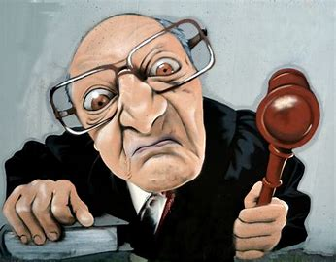

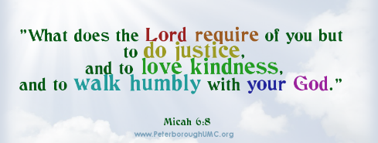
Justice
Parable of the Unjust Judge
A judge thought he was more important than anyone and even God. A woman was asking for justice. The Judge said that she was wrong. However the woman who was asking justice kept going back to him after every wrong decision that he made. Her persistence made him think about his decision. He final realised that God was the only one who knew everything. He listened to the woman and she received the justice she deserved.
When you are with your friends and with people ou do not like, do you treat them as fairly as each other? Do you treat your friends more fairly?
Virtue prayer of Justice

Slide 12
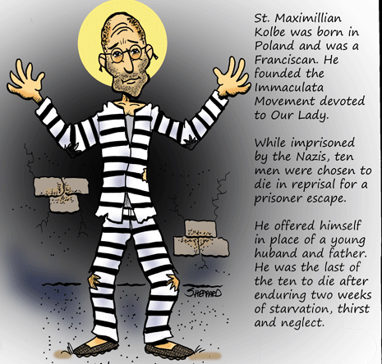
Courage
St Maximillian Kolbe was a priest during the Second World War. He was sent to a concentration camp. Whilst there he worked to help others and he prayed through Mary every day. He asked Mary for her support and love. He took strength from Mary when he offered himself to save someone else being punished. He died during this punishment and he saved the other man who had a wife and child.
Maximillian showed great courage and gave his life for another. We can show courage and like Maximillian use prayer to support us when we do not feel brave.

Slide 13
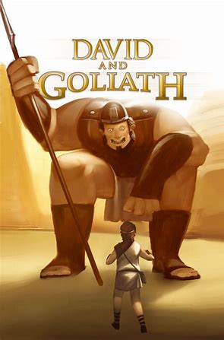
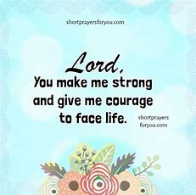
Courage
The story of David and Goliath tells us about the courage of the small boy David who stood up against the giant Goliath when no-one else wanted to. With a small stone and his sling David knocked Goliath over and won the battle for his family.
Virtue prayer of courage

Slide 14
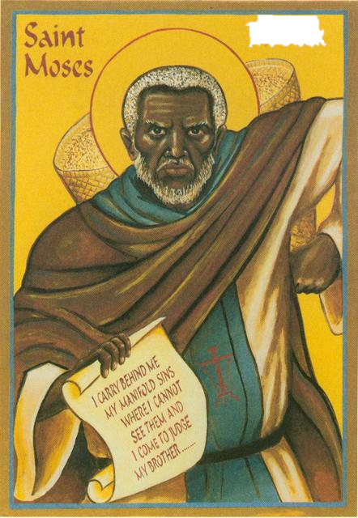

Self Control
St Moses the Strong
St Moses the strong was an Ethiopian man who spent his early life doing everything he should not do. He worshipped the wrong God and ate and drank to excess. He hurt people and was thoughtless.
One day he called out “Who is the real God?” He heard a voice respond saying to go to a particular group of monks knew the real God. He travelled to the monastery and became a believer. He changed from someone who had no self control to someone who used self control in every day of his life. He eventually was killed for his faith.
St Moses is known for his strength
because he had self control.

Slide 15
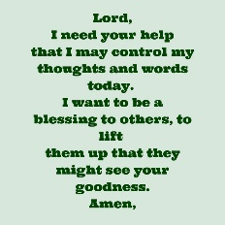
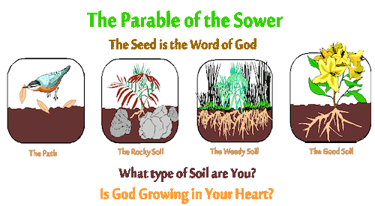
Self control
Virtue prayer of Self Control

